Slide 1
DP-601T00A: Implementing a Lakehouse with Microsoft Fabric
Notes:
Instructor notes and guidance.
This space has been left deliberately blank

Slide 2
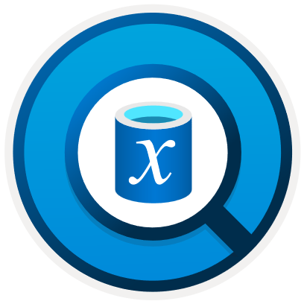


Ingest Data with Dataflows Gen2 in Microsoft Fabric
Notes:
aka.ms/fabric-dataflow Before delivering this presentation, review the associated module on Microsoft Learn (https://aka.ms/fabric-dataflow).
The goal of this presentation is to introduce how learners can use Dataflows Gen2 in Microsoft Fabric to ingest and transform data to land in a lakehouse (or elsewhere).
The estimated time to present these slides is 30 minutes.

Slide 3
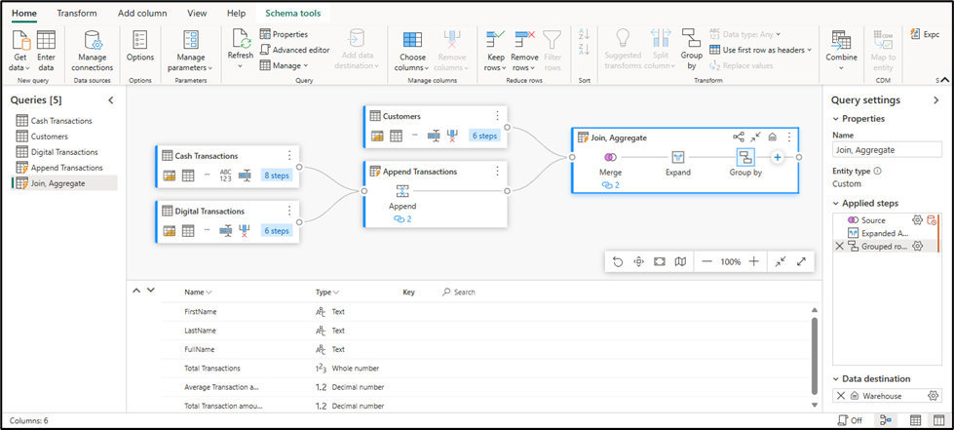
Understand Dataflows (Gen2)
Low-code graphical environment for defining ETL solutions
Extract data from multiple sources, transform it, and load it into a destination
Run dataflows independently or as an activity in a Pipeline
Notes:
There are two primary high-level features Data Factory implements: dataflows and pipelines.
1. Dataflows Gen2 enable you to leverage a low-code interface and 300+ data and AI-based transformations, letting you transform data easier and with more flexibility than any other tool.
2. Data Pipelines enable you to leverage rich out-of-the-box data orchestration capabilities to compose flexible data workflows that meet your enterprise needs. You can learn more about their capabilities in the Data Factory Spotlight: data pipelines blog post. What is a dataflow?
Dataflows are a type of cloud-based ETL (Extract, Transform, Load) tool for building and executing scalable data transformation processes.
Dataflows (Gen2) allow you to extract data from various sources, transform it using a wide range of transformation operations, and load it into a destination. Using Power Query Online also allows for a visual interface to perform these tasks.
The ability to specify an output destination along with enhanced compute time are what set Dataflows (Gen2) apart from their predecessor.
Dataflows allow you to promote reusable ETL logic that prevents the need to create more connections to your data source. Dataflows offer a wide variety of transformations, and can be run manually, on a refresh schedule, or as part of a Data Pipeline orchestration.
How does Gen2 differ from Gen1?
Dataflow Gen2 in Fabric is the evolution of Dataflow, redesigned from the ground up with more powerful compute engines, data movement capabilities to help you load data to several Fabric and Azure data destinations. Dataflows (Gen2) is only available in Fabric (not in Power BI without a Fabric license/trial).

Slide 4
Dataflow (Gen2) benefits and limitations
Benefits:
Allow self-service users access to a subset of data warehouse separately.
Optimize performance with dataflows, which enable extracting data once for reuse, reducing data refresh time for slower sources.
Simplify data source complexity by only exposing dataflows to larger analyst groups.
Ensure consistency and quality of data by enabling users to clean and transform data before loading it to a destination.
Limitations:
Not a replacement for a data warehouse.
Row-level security isn't supported.
Fabric capacity workspace is required.
Notes:
There's more than one way to ETL or ELT data in Microsoft Fabric. Consider the benefits and limitations for using Dataflows (Gen2).

Slide 5
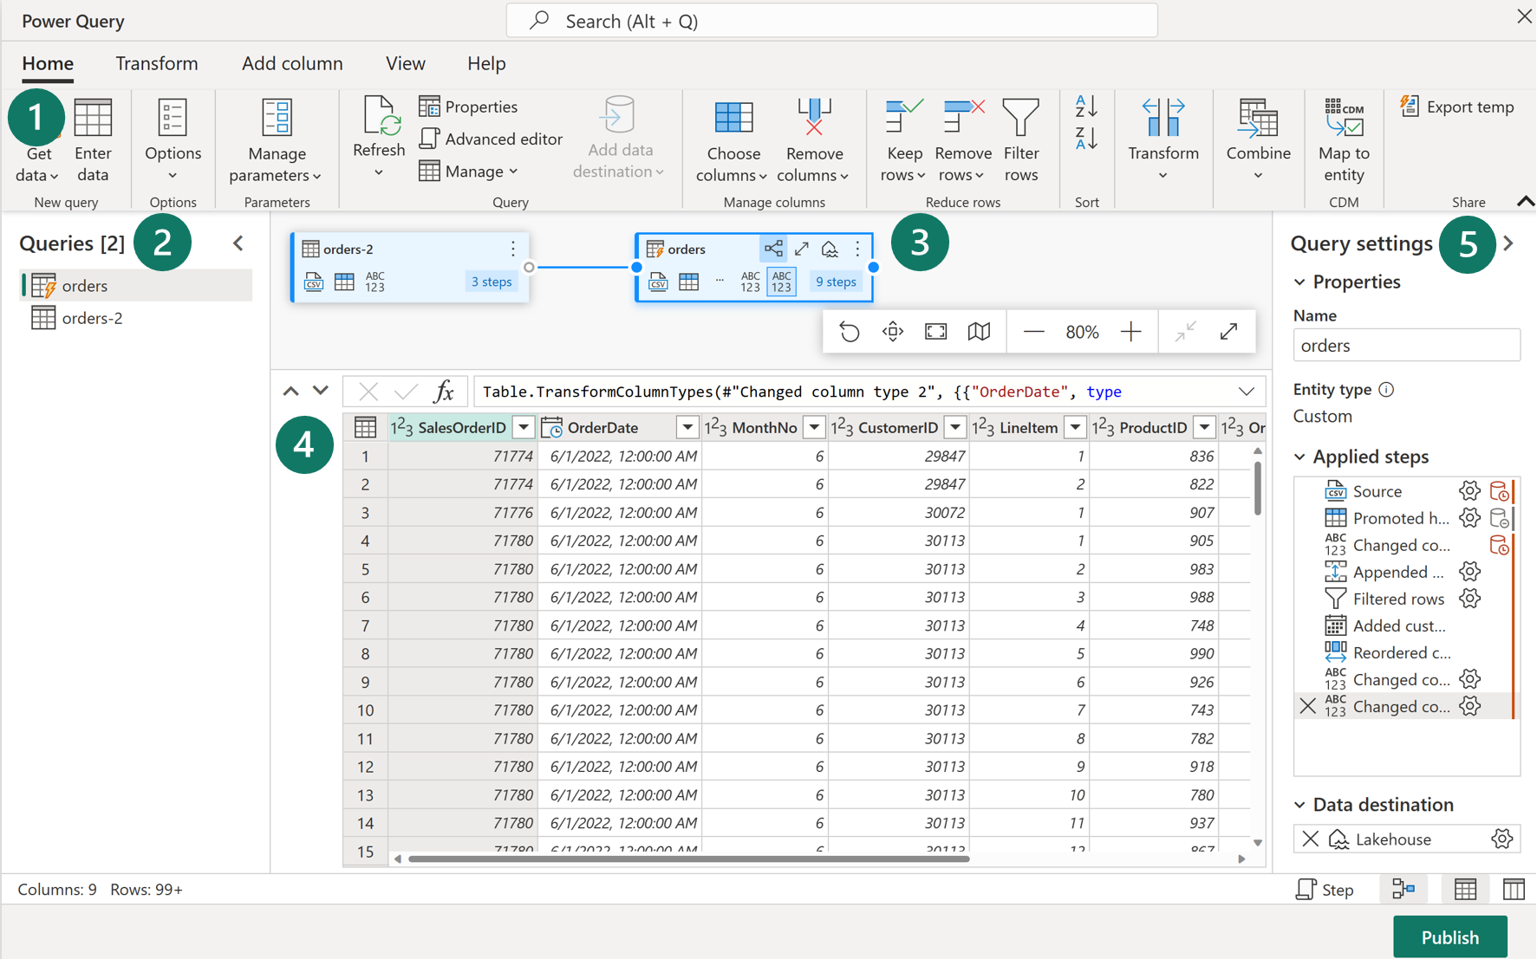
Explore dataflows (Gen2) in Microsoft Fabric
1. Power Query ribbon
2. Queries pane
3. Diagram view
4. Data preview
5. Query settings pane
Notes:
1. Power Query ribbon
Dataflows (Gen2) support a wide variety of data source connectors. Common sources include cloud and on-premises relational databases, Excel or flat files, SharePoint, SalesForce, Spark, and of course Fabric Lakehouses. Then there are numerous data transformations possible, such as:
Filter and Sort rows
Pivot and Unpivot
Merge and Append queries
Split and Conditional split
Replace values and Remove duplicates
Add, Rename, Reorder, or Delete columns
Rank and Percentage calculator
Top N and Bottom N
2. Queries pane
The Queries pane shows you the different data sources - now called queries. Rename, duplicate, reference, and enable load are some of the options available.
3. Diagram view
The Diagram View allows you to visually see how the data sources are connected and the different applied transformations. Note this can be turned on and off on the view tab of the ribbon.
4. Data Preview pane
The Data Preview pane only shows a subset of data to allow you to see which transformations you should make and how they affect the data. You can also interact with the preview pane by dragging and dropping columns to change order or right-clicking on columns to filter or make changes.
5. Query Settings pane
The Query Settings pane primarily includes Applied Steps. Each transformation you do is tied to a step, some of which are automatically applied when you connect the data source. Depending on the complexity of the transformations, you may have several applied steps for each query.
While this visual interface is helpful, you can also view the M code through Advanced editor.

Slide 6
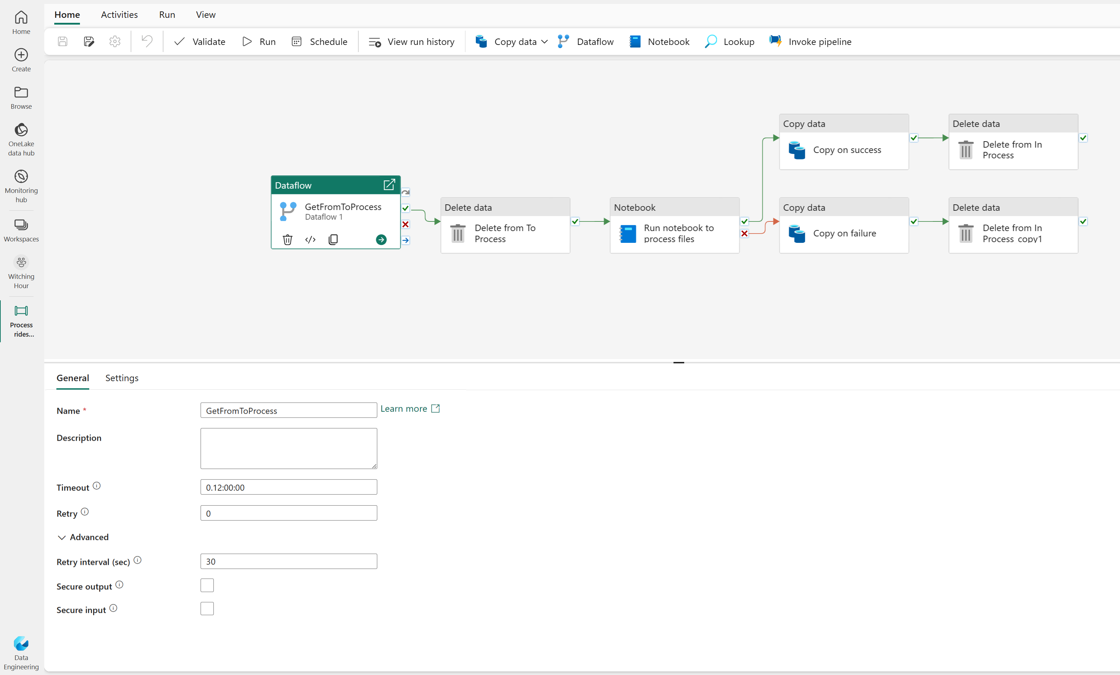
Integrate Dataflows (Gen2) and Pipelines in Microsoft Fabric
Use a dataflow to define an ETL process
Add it as an activity to a pipeline
Add more activities for subsequent (or previous) processing tasks to define an end-to-end orchestrated solution
Notes:
The combination of dataflows and pipelines is useful when you need to perform additional operations on the transformed data. Note that pipelines will be discussed in detail in the next section.
Data pipelines are easily created in the Data Factory and Data Engineering workloads. Pipelines are a common concept in data engineering and offer a wide variety of activities to orchestrate. Some common activities include:
Copy data
Incorporate Dataflow
Add Notebook
Get metadata
Execute a script or stored procedure
Pipelines provide a visual way to complete activities in a specific order. You can use a dataflow for data ingestion and transformation, and landing into a Lakehouse using dataflows. Then incorporate the dataflow into a pipeline to orchestrate extra activities, like execute scripts or stored procedures after the dataflow has completed.

Slide 7
Exercise
Create and use a Dataflow (Gen2) in Microsoft Fabric
Notes:
https://aka.ms/mslearn-fabric-dataflow The estimated time to complete this exercise is 30 minutes.

Slide 8

Knowledge check
What is a Dataflow (Gen2)?
A hybrid database that supports ACID transactions.
A way to export data to Power BI Desktop.
A way to import and transform data with Power Query Online.
Which Fabric experience lets you create a Dataflow (Gen2)??
Real-time analytics
Data warehouse
Data Factory
How do Dataflows (Gen2) in Microsoft Fabric facilitate collaboration?
By providing a shared and collaborative environment for data transformation and integration.
By enabling real-time data streaming and event processing.
By integrating with popular business intelligence tools for data visualization.
Notes:
Allow students a few minutes to think about the questions, and then use the animated slide to reveal the correct answers.

Slide 9

Further reading
Ingest Data with Dataflows Gen2 in Microsoft Fabric
https://aka.ms/fabric-dataflow
Notes:
Encourage students to review the online material on Microsoft Learn on which this presentation is based.
More info on dataflows (Gen2) behind the scenes: https://blog.fabric.microsoft.com/blog/data-factory-spotlight-dataflows-gen2#

Slide 10

Use Data Factory pipelines in Microsoft Fabric
Notes:
https://aka.ms/fabric-pipeline Before delivering this section, review the associated module on Microsoft Learn (https://aka.ms/fabric-pipeline).
The goal of this presentation is to provide an introduction to using Data Factory pipelines to orchestrate the flow of data in Microsoft Fabric.
The estimated time to present these slides is 30 minutes.

Slide 11
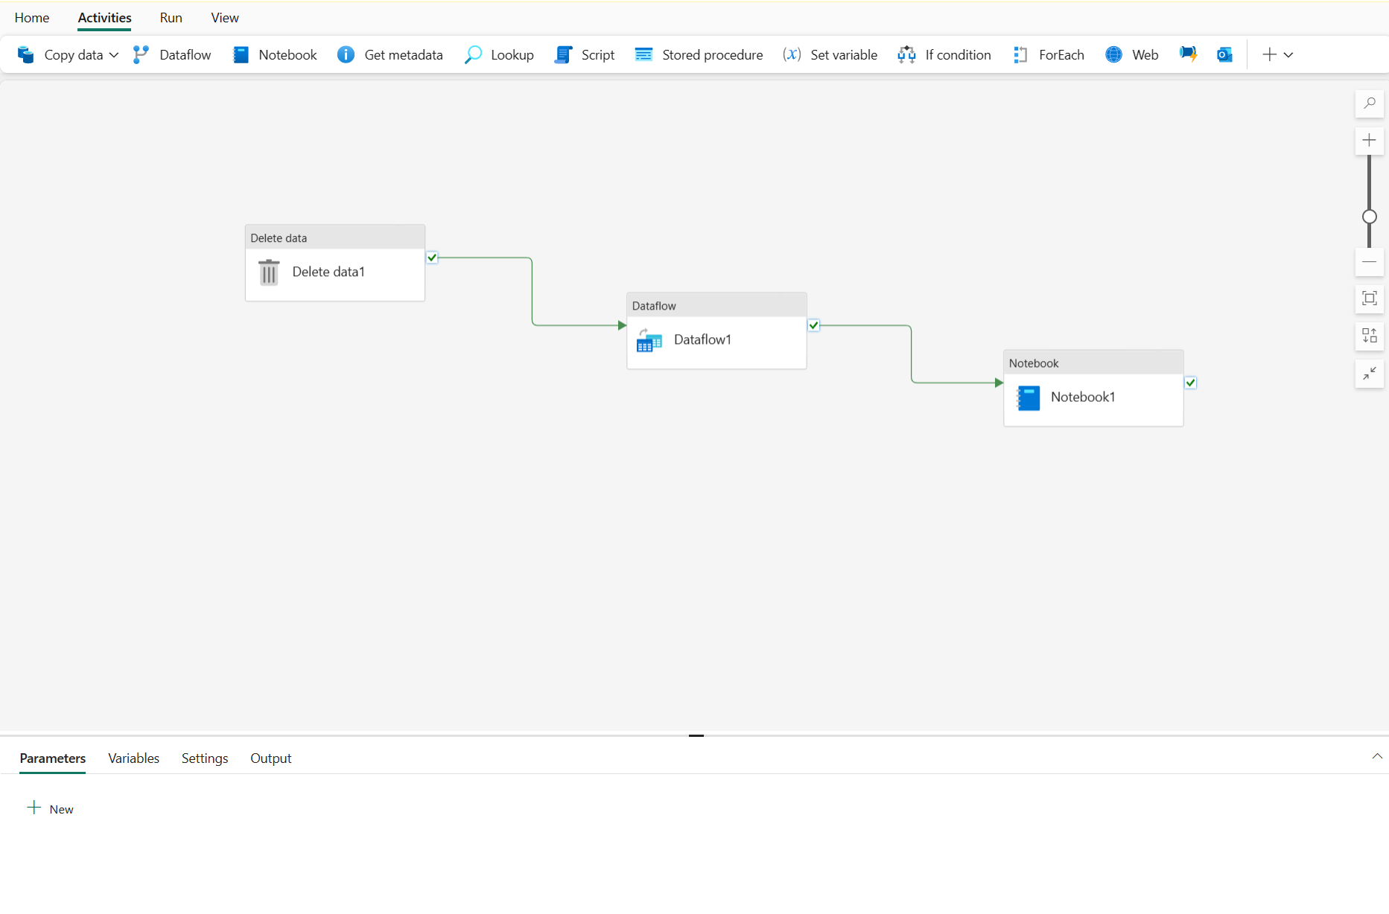
Pipelines in Microsoft Fabric
Pipeline concepts:
Activities
Data transformation
Control flow
Parameters
Pipeline runs
Notes:
This is a build slide. There are two primary high-level features Data Factory implements: dataflows and pipelines.
Data Pipelines enable you to leverage rich out-of-the-box data orchestration capabilities to compose flexible data workflows that meet your enterprise needs. You can learn more about their capabilities in the Data Factory Spotlight: data pipelines blog post.
Dataflows Gen2 enable you to leverage a low-code interface and 300+ data and AI-based transformations, letting you transform data easier and with more flexibility than any other tool.
Pipelines in Microsoft Fabric encapsulate a sequence of activities that perform data movement and processing tasks. You can use a pipeline to define data transfer and transformation activities, and orchestrate these activities through control flow activities that manage branching, looping, and other typical processing logic. The graphical pipeline canvas in the Fabric user interface enables you to build complex pipelines with minimal or no coding required.
Click to reveal Core pipeline concepts
Activities
Activities are the executable tasks in a pipeline. You can define a flow of activities by connecting them in a sequence. The outcome of a particular activity (success, failure, or completion) can be used to direct the flow to the next activity in the sequence.
There are two broad categories of activity in a pipeline.
Data transformation activities - activities that encapsulate data transfer operations, including simple Copy Data activities that extract data from a source and load it to a destination, and more complex Data Flow activities that encapsulate dataflows (Gen2) that apply transformations to the data as it is transferred.
Control flow activities - activities that you can use to implement loops, conditional branching, or manage variable and parameter values.
Parameters
Pipeline runs

Slide 12
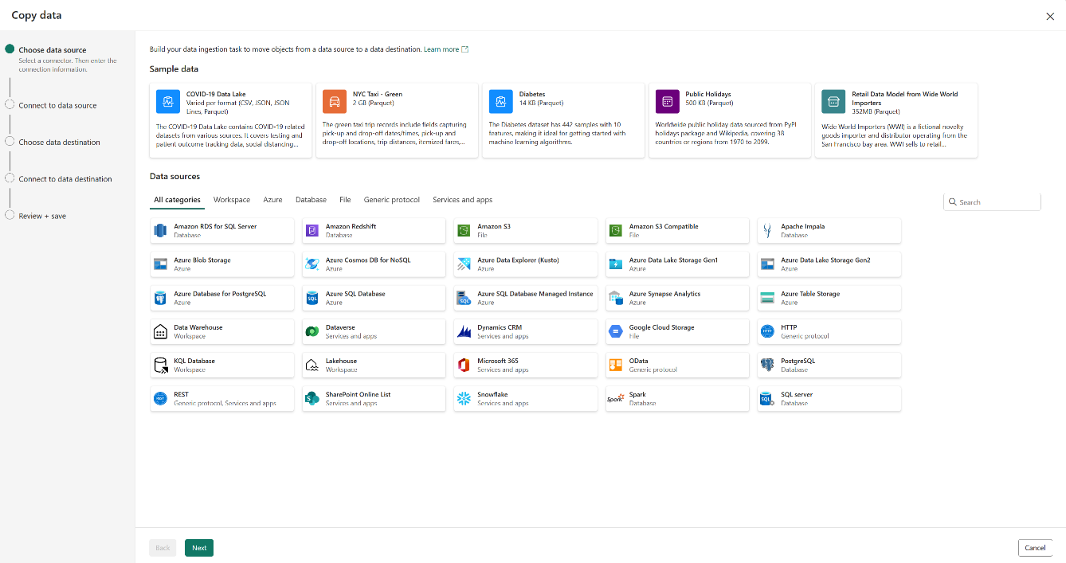
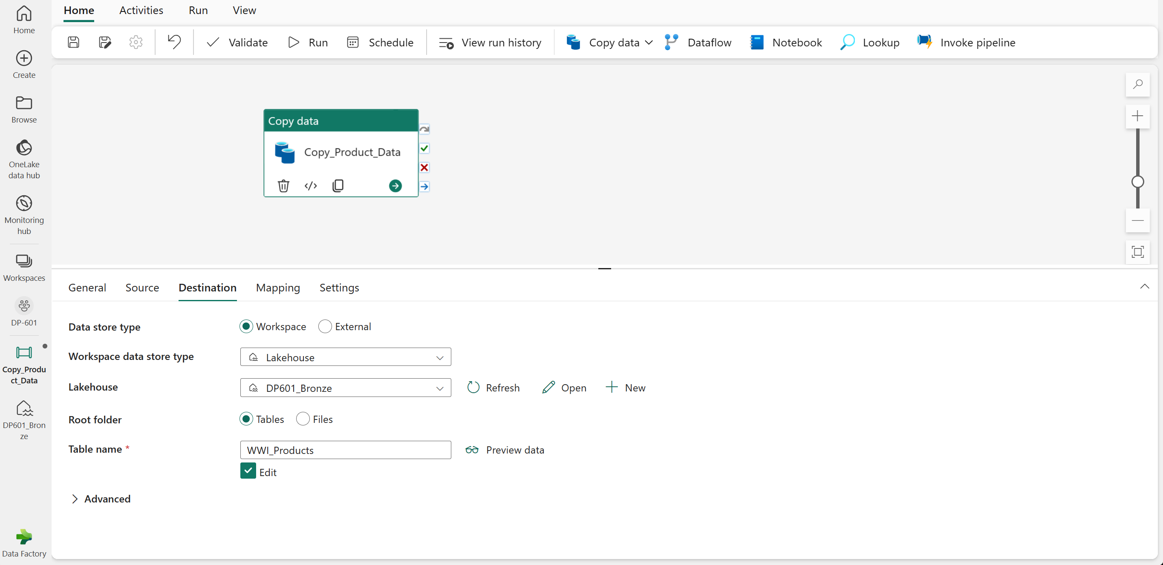
Common activities – Copy Data
1. Use the copy data tool.
2. Edit the settings below the pipeline canvas.
Notes:
This is a build slide.
The Copy Data activity is one of the most common uses of a data pipeline. Many pipelines consist of a single Copy Data activity that is used to ingest data from an external source into a lakehouse file or table.
The Copy Data tool - When you add a Copy Data activity to a pipeline, a graphical tool takes you through the steps required to configure the data source and destination for the copy operation. A wide range of source connections is supported, making it possible to ingest data from most common sources.
Click
Copy Data activity settings - After you've added a Copy Data activity to a pipeline, you can select it in the pipeline canvas and edit its settings in the pane underneath.
Use the Copy Data activity when you need to copy data directly between a supported source and destination without applying any transformations, or when you want to import the raw data and apply transformations in later pipeline activities.
If you need to apply transformations to the data as it is ingested, or merge data from multiple sources, consider using a Data Flow activity to run a dataflow (Gen2). You can use the Power Query user interface to define a dataflow (Gen2) that includes multiple transformation steps, and include it in a pipeline.

Slide 13
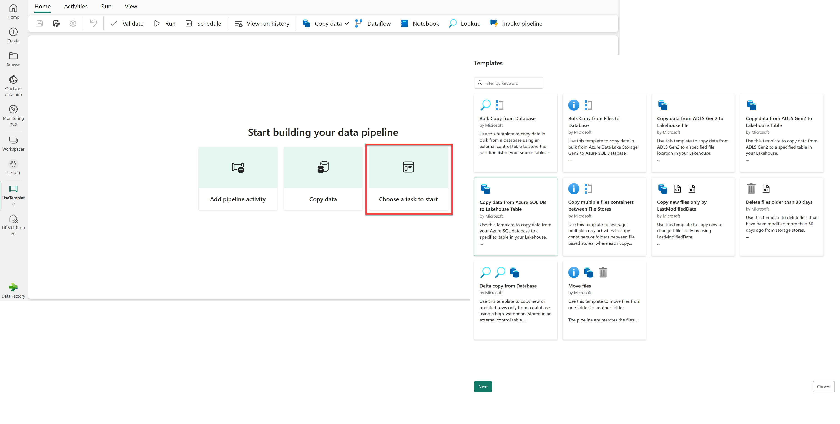
Common activities - pipeline templates
Use templates to build common pipeline scenarios.
Notes:
There are many common pipeline scenarios for which Microsoft Fabric includes predefined pipeline templates that you can use and customize as required.
To create a pipeline based on a template, select the Choose a task to start tile in a new pipeline.

Slide 14
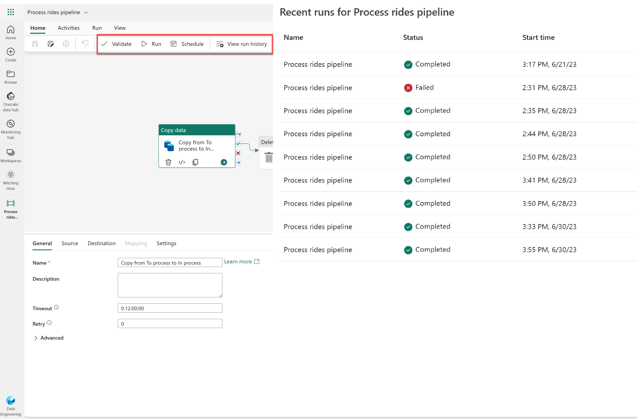
Run and monitor pipelines
Validate
Run
Schedule
View run history
Notes:
When you have completed a pipeline, you can use the Validate option to check that is configuration is valid, and then either run it interactively or specify a schedule.
The Run button will manually trigger a data pipeline run.
When you schedule a data pipeline run, you can choose the frequency that your pipeline runs. Select Schedule, found in the top banner of the Home tab, to view your options. By default, your data pipeline won't be set on a schedule.
When you view a pipeline run history from the workspace page, you can select the Run start value to see the details of an individual run; including the option to view the individual execution time for each activity as a Gantt chart.

Slide 15
Exercise
Ingest data with a pipeline
Notes:
https://aka.ms/mslearn-fabric-pipeline
The estimated time to complete this exercise is 60 minutes.

Slide 16
Knowledge check
What is a data pipeline?
A special folder in OneLake storage where data can be exported from a lakehouse.
A sequence of activities to orchestrate a data ingestion or transformation process.
A saved Power Query.
You want to use a pipeline to copy data to a folder with a specified name for each run. What should you do?
Create multiple pipelines - one for each folder name.
Use a Dataflow (Gen2).
Add a parameter to the pipeline and use it to specify the folder name for each run.
You have previously run a pipeline containing multiple activities. What's the best way to check how long each individual activity took to complete?
Rerun the pipeline and observe the output, timing each activity.
View the run details in the run history.
View the Refreshed value for your lakehouse's default dataset
Notes:
Allow students a few minutes to think about the questions, and then use the animated slide to reveal the correct answers.

Slide 17
Further reading
Use Data Factory pipelines in Microsoft Fabric
https://aka.ms/fabric-pipeline
Notes:
Encourage students to review the online material on Microsoft Learn on which this presentation is based.

